Slide 1

CSC 533: Privacy in the Digital Age (Fall 2020) Lecture 5: Introduction to Differential Privacy
Anupam Das
Aug 25, 2020

Slide 2
Goals for today
Why we might use differential privacy?
What it means to achieve differential privacy?
Some contents are borrowed from online material provided by Vitaly Shmatikov, Aaron Roth, Elaine Shi, Kobbi Nissim

Slide 3
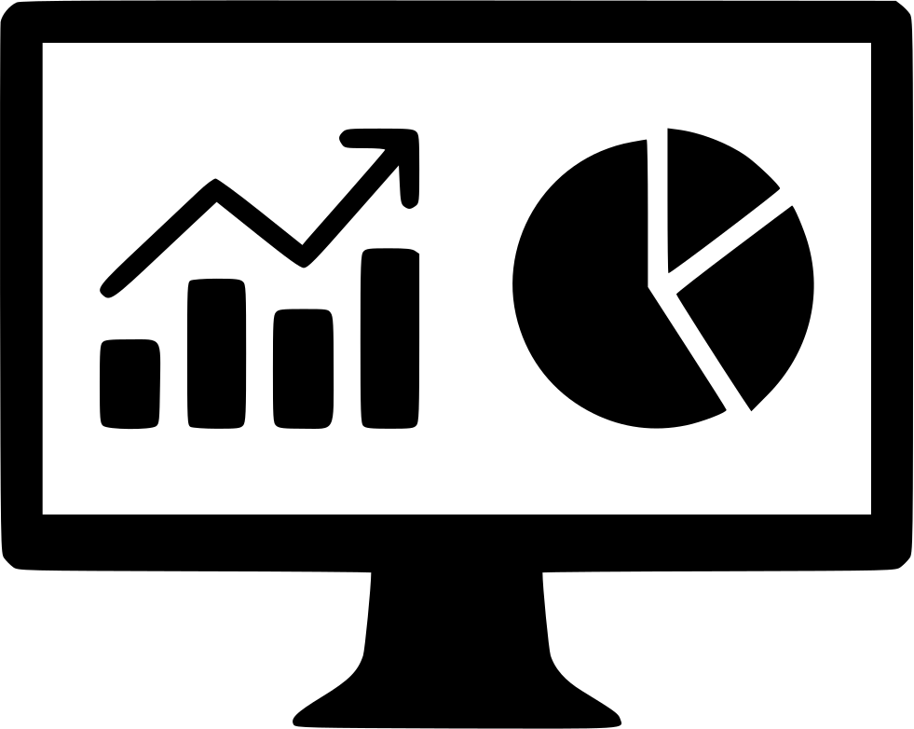

Background: Privacy-preserving analytics
Database with sensitive information
Two conflicting goals
Utility: Users can extract “useful” statistics
Privacy: Individual information stays hidden
How can these be formalized?
privacy
utility

Slide 4
Basic setting
x₁
Sanitization
query 1
x₂
San
answer 1
Users
(government, researchers, marketers, …)
DB=
x₃


query T
x_{n-1}
answer T
x_{n}
¢
¢
¢
random coins
We learned some forms of sanitization:
Generalization and suppression

Slide 5
Examples of sanitization methods
Input perturbation
Add random noise to database, release
Summary statistics
Means, variances
Marginal totals
Regression coefficients
Output perturbation
Summary statistics with noise

Slide 6
Settings for data analytics
Non-interactive
publish statistics then destroy data
publish micro-data (sanitized data)
Interactive
a classical research problem for statistical databases
prevent query inferences – malicious users submit multiple queries to infer private information about some individual

Slide 7
Privacy-preserving statistics: Non-Interactive setting
generalize, suppress
x₁
…
x_{n}
Analyst
Sanitized Database D’
Database D
maintained by
trusted curator
example:
k-anonymity
Census data
Health data
Network data
…

Slide 8
What does this 3-anonymous table reveal?
 | Non-Sensitive Data |  |  | Sensitive Data
# | ZIP | Age | Nationality | Condition
1 | 1305* | < 40 | * | Heart Disease
2 | 1305* | < 40 | * | Viral Infection
3 | 1305* | < 40 | * | Cancer
5 | 1485* | > 39 | * | Cancer
6 | 1485* | > 39 | * | Heart Disease
7 | 1485* | > 39 | * | Viral Infection
9 | 1306* | < 40 | * | Heart Disease
10 | 1306* | < 40 | * | Viral Infection
11 | 1306* | < 40 | * | Cancer
Is there anyone in zip code 13660 in the table?
Is there anyone with Flu in the table?
How many are age 39?
How many people in the table can be in the zip code 13061?
Remember Negative/Null response is useful information
Ask as many questions you want because the data is released
Risk: Allows us to infer information about the original table

Slide 9
Privacy-preserving statistics: Interactive setting
# individuals with salary > $30K
Query f
x₁
…
x_{n}
f(D)
Not respond
Analyst
Database D
maintained by
trusted curator
Census data
Health data
Network data
…

Slide 10
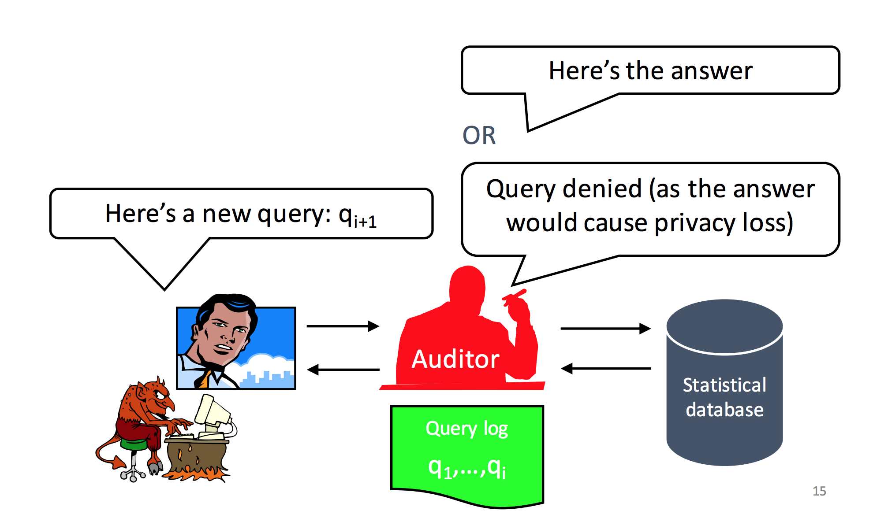
Illustrative example of interactive setting

Slide 11
Why interactive models?
May be possible to better balance privacy and utility
Easier when talking about privacy for specific queries
The full dataset is not make public

Slide 12
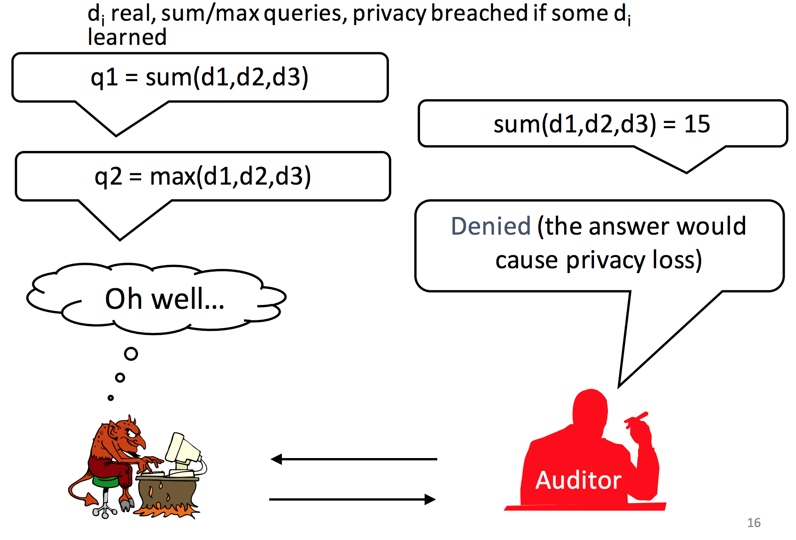
Does interactive setting prevent inference?
could d1=d2=d3=5?
Auditor has to do a lot of work

Slide 13
Classical intuition for privacy
“If the release of statistics S makes it possible to determine the value [of private information] more accurately than is possible without access to S, a disclosure has taken place.” [Dalenius 1977]
Access to a statistical database should not enable one to learn anything about an individual that could not be learned without access
Naturally relates to semantic security in cryptosystems
Anything about the plaintext that can be learned from a ciphertext can be learned without the ciphertext

Slide 14
Problems with classical intuition
Too strong: It is not possible to design any non-trivial mechanism that satisfies such strong notion of privacy
Background knowledge combined with coarse statistics can still allow inferences
Illustrative Example
Sensitive information: The height of Alice
Background knowledge: Alice is 2 inches shorter than the average US woman
Output statistic: Average height of US women
Inference: Alice’s height= avg. height – 2 inch … even if her record is not in the database!

Slide 15

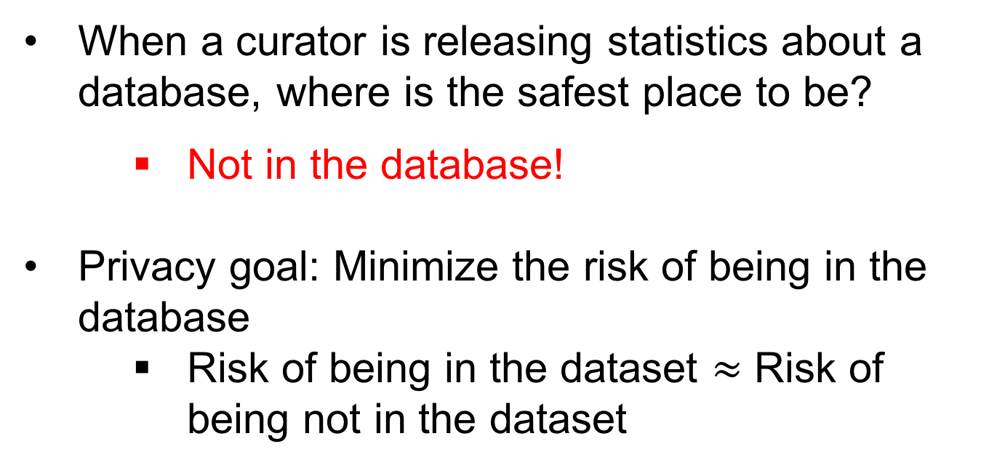
Towards a better privacy goal
When a curator is releasing statistics about a database, where is the safest place to be?
Not in the database!
Privacy goal: Minimize the risk of being in the database
Risk of being in the dataset $≈$ Risk of being not in the dataset
Plausible deniability of being in the dataset!

Slide 16
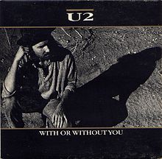
Differential privacy: Basic idea
[Dwork, McSherry, Nissim, Smith 2006]
Released statistic is about the same
if any individual’s record is
removed from the database
Notes:
If there is already some risk of revealing a secret of C by combining auxiliary information and something learned from DB, then that risk is still there but not increased by C’s participation in the database
C is no worse off because her record is included in the computation

Slide 17
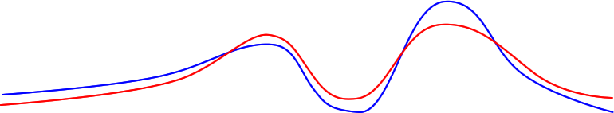
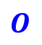

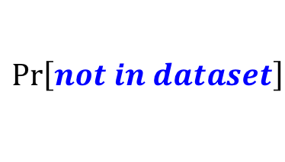
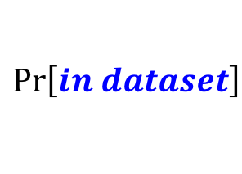
Differential privacy: Informally
D
D’
Curator’s output on D is very similar to Curator’s output on D’
Receiver can’t tell if a user is in the database or not
$$\operatorname{Pr}\left[in dataset\right]$$
Curator
Curator
difference
$$\operatorname{Pr}\left[not in dataset\right]$$
$$O$$
Output
$$≈$$
Output’

Slide 18
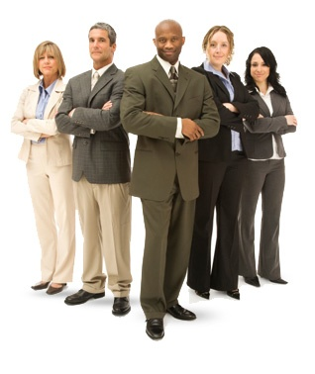
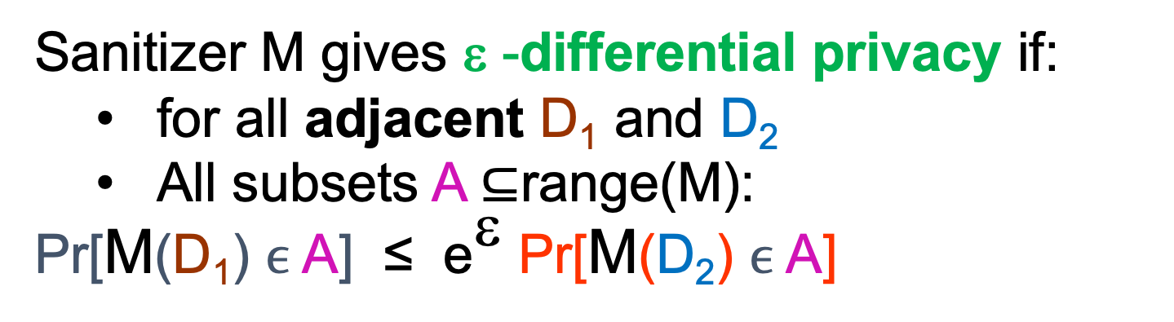
Differential privacy: Formal definition
Sanitizer M gives ε -differential privacy if:
for all adjacent D₁ and D₂
All subsets A $⊆$range(M):
Pr[M(D₁) $ϵ$ A] ≤ e^{ε} Pr[M(D₂) $ϵ$ A]
Differing in
one user
Participation in the data set poses no additional risk
Adversary does not distinguish whether I supplied real or fake input
Probability taken over randomness of M (analytic function)
ratio bounded
Pr [response]
For small value of ε, e^{ε} = 1+ ε
Responses:
X
X
X

Slide 19
Interpreting differential privacy
DP is parameterized. Smaller 𝜀 means better privacy.
Allows bounding privacy loss of a combination of analyses via composition theorems.
“Automatic” opt-out: I am protected (almost) as if my info is not used at all.
Plausible deniability: I can claim any value for my information as outcome is (almost) as likely with that value.
I incur limited risk: Contributing my real info can increase the probability I will be denied insurance by at most 1%.
When compared with not participating, or contributing fake info.

Slide 20

Differential privacy: Illustration
b₁
b₂
b₃
b=

b_{n-1}
b_{n}
Distributions at “distance” < ε
Neighboring: One entry modified
M
b₁
b₂’
b₃
b’=
M(b’)

b_{n-1}
b_{n}
M
Slide credit: Kobbi Nissim

Slide 21
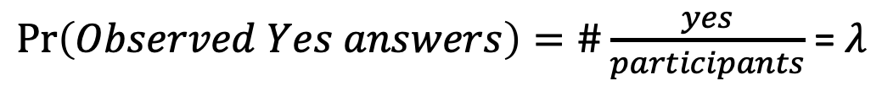
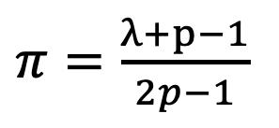
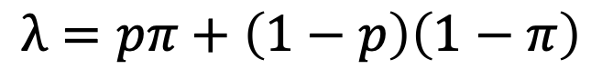

Random response: Another approach
Answer truthfully
Participants are asked to flip a coin and respond based on outcome
The overall responses should provide analysts with the desired statistics
Answer untruthfully
We can approximate the actual fraction of users who have a sensitive attribute
$\operatorname{Pr}\left(Observed Yes answers\right)=\#\frac{yes}{participants}$= $λ$
$$λ=pπ+\left(1−p\right)\left(1−π\right)$$
$π=\frac{λ+p−1}{2p−1}$
$$\operatorname{Pr}\left(True Yes answers\right)= π$$

Slide 22
Notable properties of DP
Adversary knows arbitrary auxiliary information
No linkage attacks
Oblivious to data distribution
Sanitizer need not know the adversary’s prior distribution on the DB

Slide 23
Recap: Differential privacy
Promise: an individual will not be affected, adversely or otherwise, by allowing his/her data to be used in any study or analysis, no matter what other studies, datasets, or information sources, are available”
Idea: Privacy is about protecting against inferences using your data.
“An analysis of a dataset D is private if the data analyst knows almost no more about Alice after the analysis than she would have known, had she conducted the same analysis on an identical database with Alice’s data removed.”

Slide 24
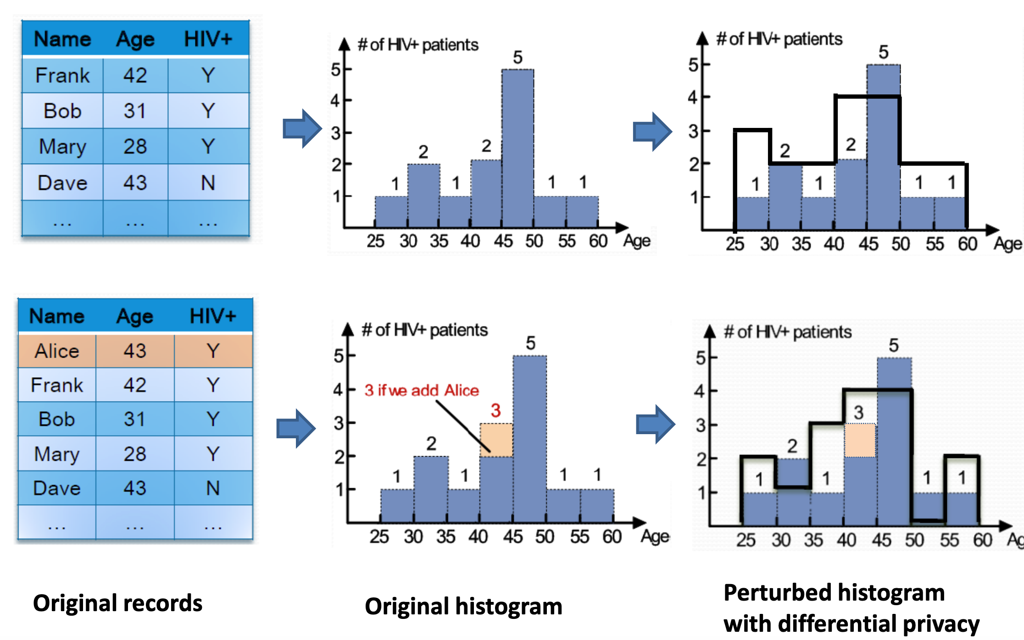
Differential privacy: Example

Slide 25
Is DP just a theory?
Is anyone using DP?

Slide 26
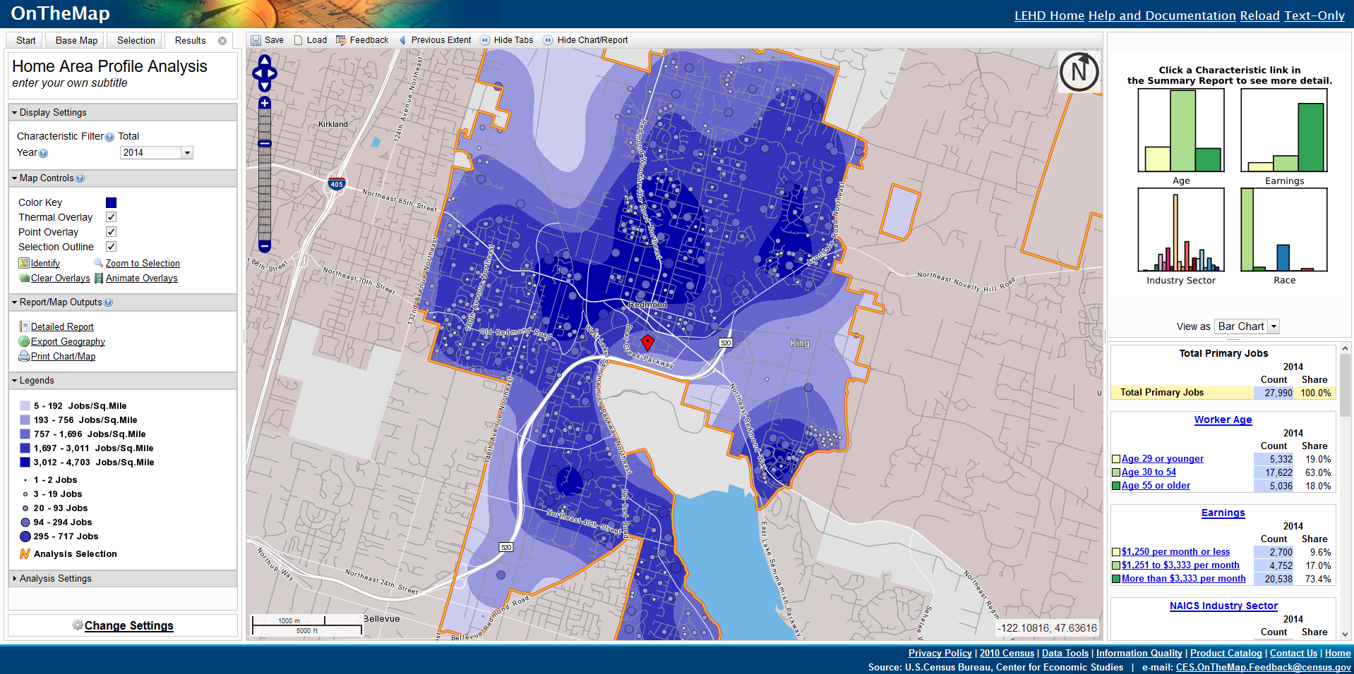
U.S. Census Bureau (2008 AD)
http://onthemap.ces.census.gov
Notes:
Launched in 2006, OnTheMap is an application that offers visualizations of household and employee concentrations. Starting in 2006, the application employs Differential Privacy to generate a synthetic dataset describing household concentrations for employees. The first map in the slide represents the concentration of employee households for the city or Redmond, WA. The darker the blue, the greater the number of workers that live in the corresponding area (this is the data that is generated using differential privacy). For comparison, the second map presents a visualization of where jobs are located. The darkest area at the bottom left of the city is the area where Microsoft is located. Graphs and tables on the right side of either image break down the worker population in the area by age, earnings, industry sector and race (scrolling down on that right-side panel we can see the explanation of what each color means). Explanations for Age and earnings graphs can be seen in the slide. For industry sector, not surprisingly, the largest bar represents the “Information” sector and the second largest bar corresponds to “Professional, Scientific and Technical Services.” For race, the largest bar is “White Alone” and the second largest bar is “Asian.”
The viewer may wonder why it is necessary to generate synthetic data to present a visualization where jobs and households are so closely packed. The answer is that most areas in the map do not have as high a concentration of jobs and, in such cases, it would be easy to identify specific households.

Slide 27
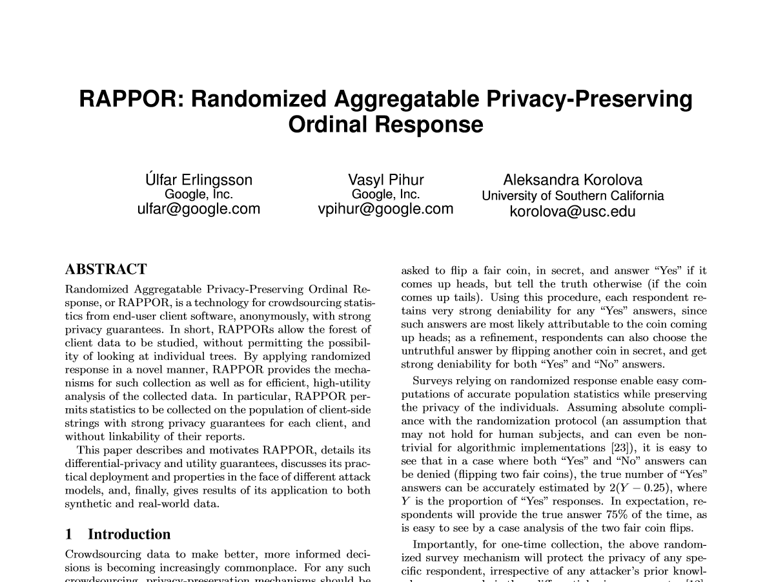
Google (2014)
Notes:
Add date

Slide 28
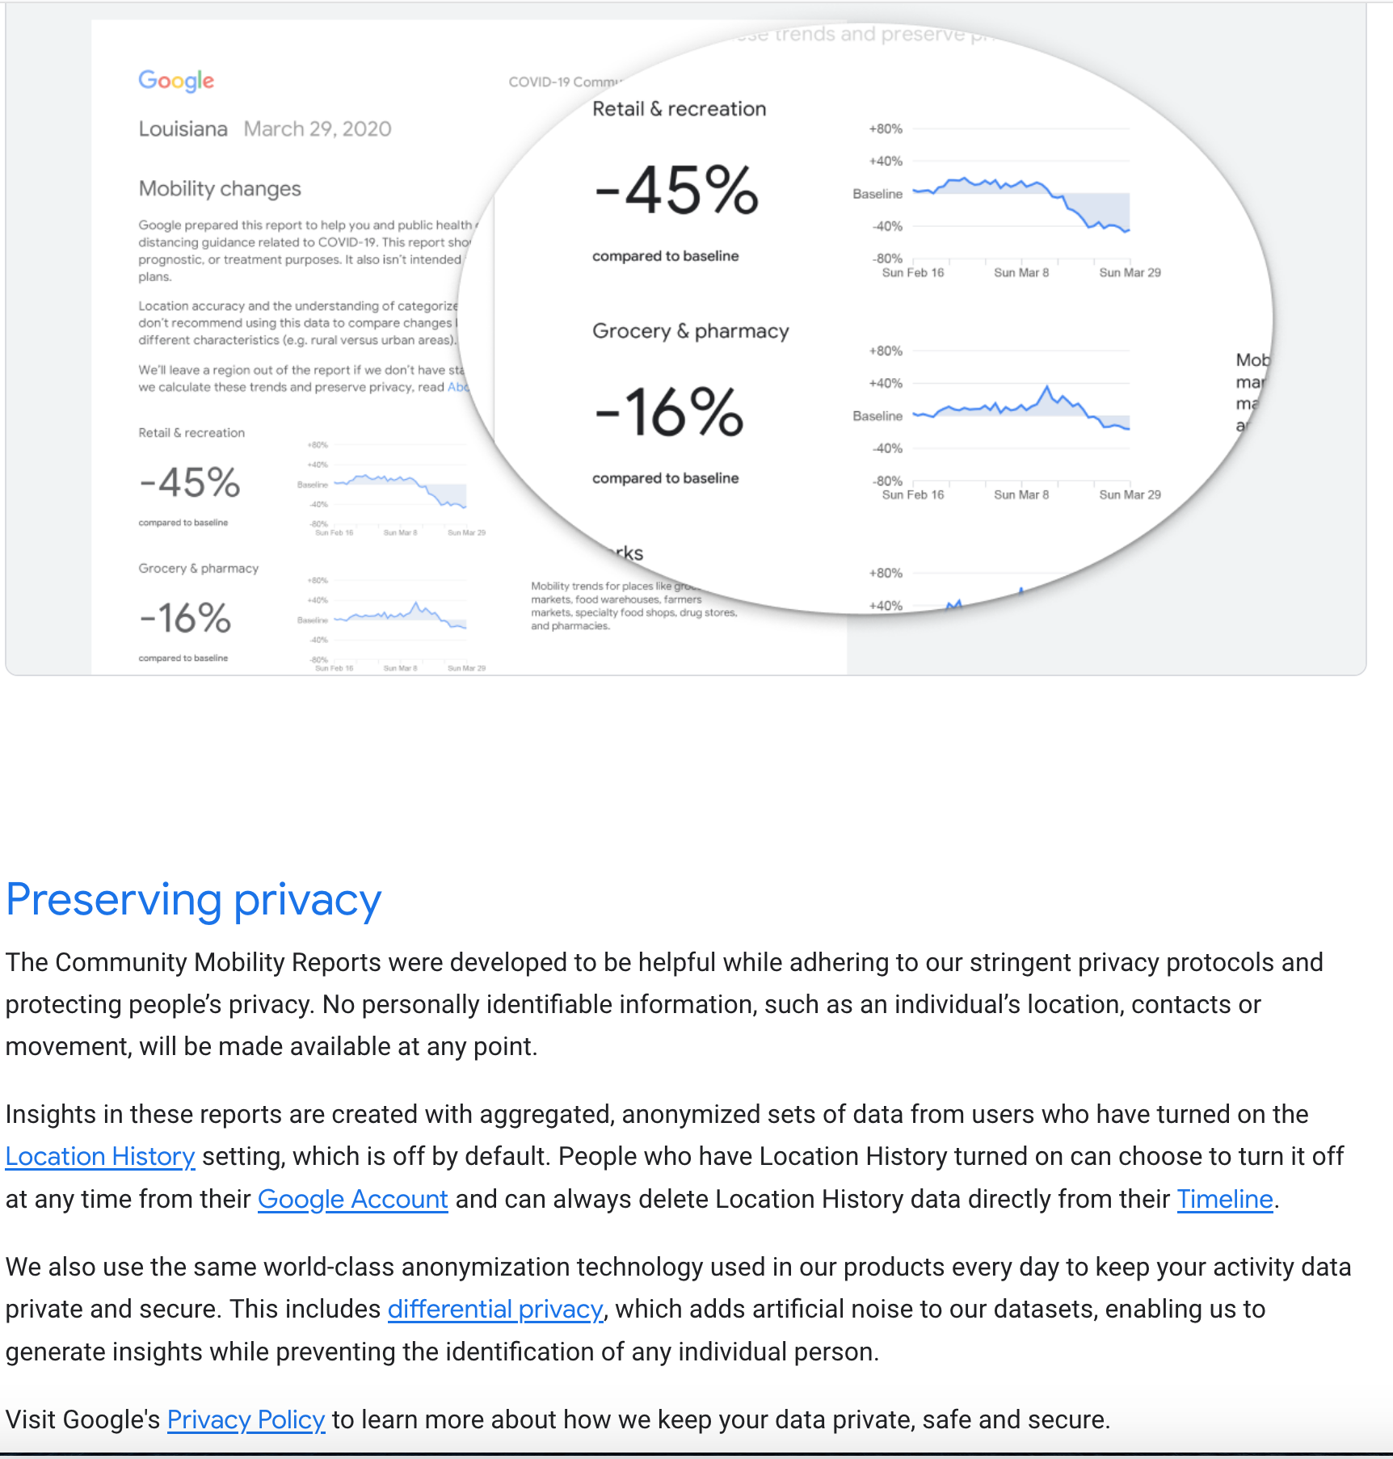
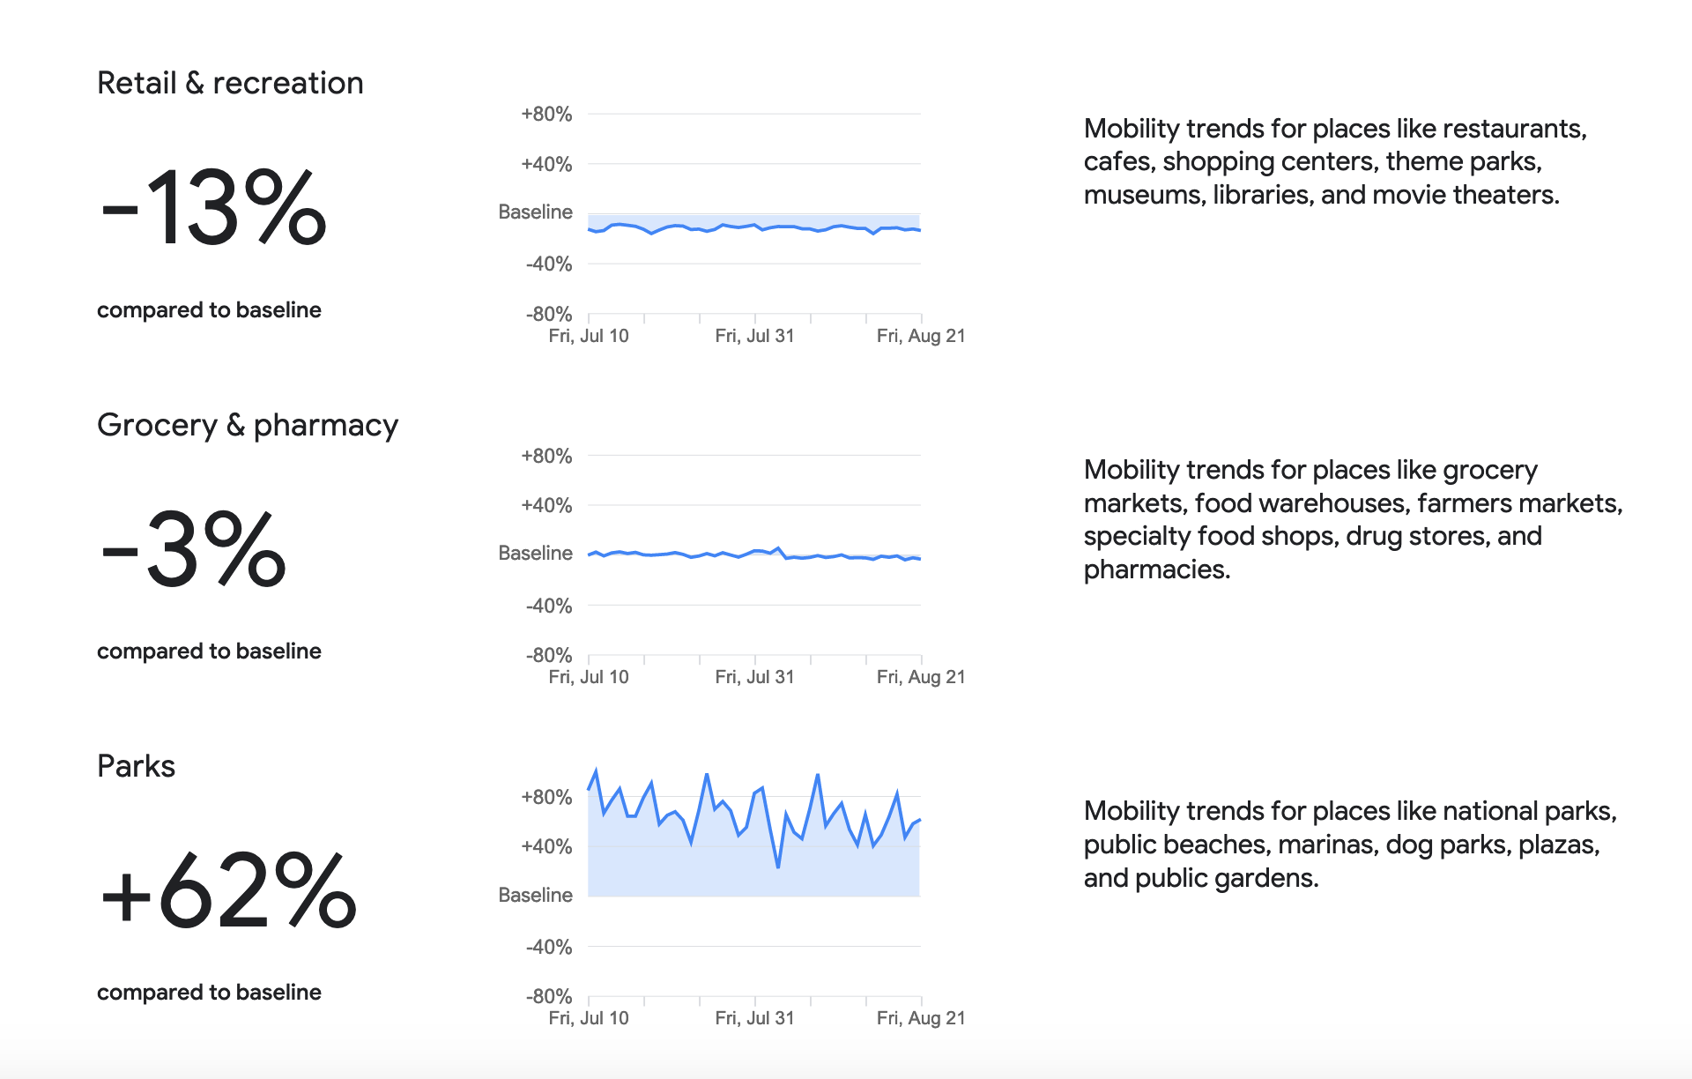
Covid-19 mobility data
https://www.google.com/covid19/mobility/
https://github.com/google/differential-privacy

Slide 29
Apple (2016)

Slide 30

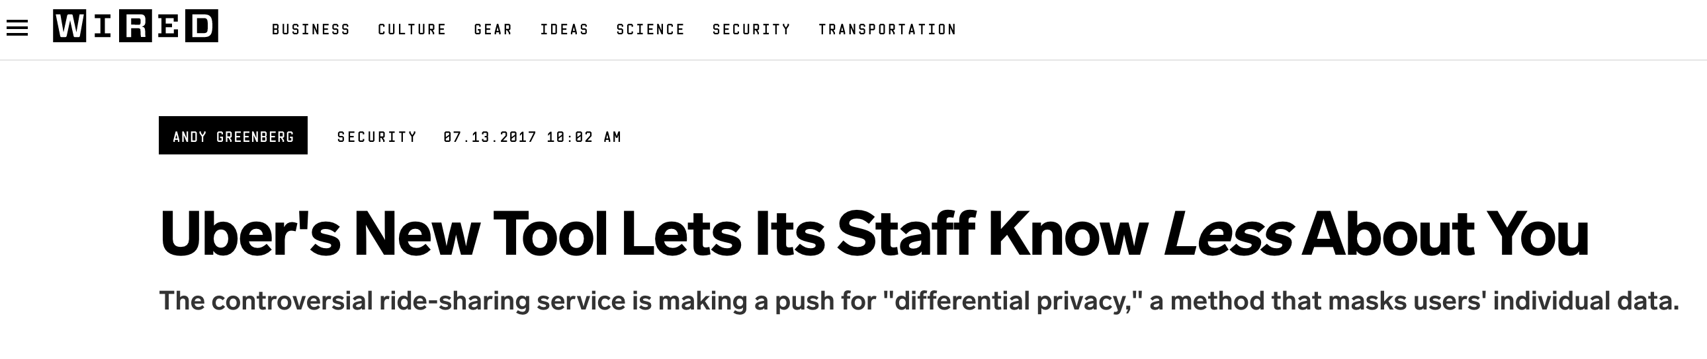
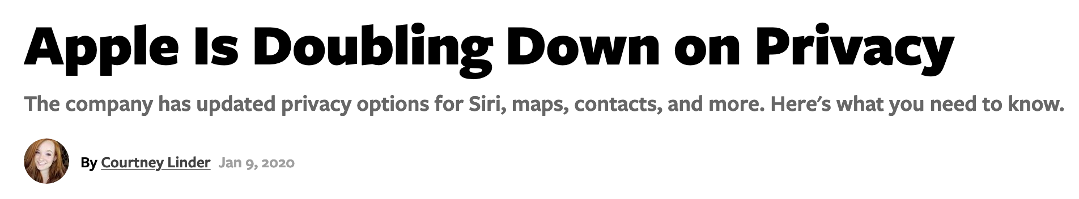
Many companies are refining DP

Slide 31
Is DP being promoted by regulation?
Regulatory groups (e.g. FTC, ICO) have not offered specific differential privacy guidance, although often encourage anonymization
FTC: "does not provide specific technical guidance in areas like [anonymization], which are constantly changing”
ICO’s (information commissioner office) anonymization guidance talks about differential privacy-like noise addition and k-anonymity, but doesn’t give specific guidance
Regulators have paid too much attention to PIIs.
“BROKEN PROMISES OF PRIVACY”, Paul Ohm
Faults laws/regulations for relying on PII removal for anonymization

Slide 32
Useful links
Microsoft: Privacy Integrated Queries (PINQ)
https://www.microsoft.com/en-us/research/project/privacy-integrated-queries-pinq/
Uber Releases Open Source Project for Differential Privacy
https://medium.com/uber-security-privacy/differential-privacy-open-source-7892c82c42b6
Apple’s ‘Differential Privacy’ Is About Collecting Your Data—but Not ​Yourdata
https://www.wired.com/2016/06/apples-differential-privacy-collecting-data/
RAPPOR: Randomized Aggregatable Privacy-Preserving Ordinal Response (Google)
https://static.googleusercontent.com/media/research.google.com/en//pubs/archive/42852.pdf
Census: Protecting the Confidentiality of America’s Statistics: Adopting Modern Disclosure Avoidance Methods at the Census Bureau
https://www.census.gov/newsroom/blogs/research-matters/2018/08/protecting_the_confi.html

Slide 33
Interesting video
Cynthia Dwork: A lecture on the definition of differential privacy
https://www.youtube.com/watch?v=lg-VhHlztqo

Slide 34
Project Proposal
Deadline | Task
08/22 (extended) | Project selection due (small paragraph)
08/24 (extended) | Project assigned to team group
08/31 (extended) | Project proposal, 1-3 pages (10 points)
10/06 | Project progress report, 4-8 pages (30 points)
11/16 | Final report, 8-10 pages (60 points)
One submission per group (mention the team member names and unity IDs). Submission should be in PDF
Use Latex with font size 11pt and single space. Use the ACM Latex style file available here ACM_LATEX. Use the sample-sigconf.tex sample and change the font size to 11pt [\documentclass[sigconf,11pt]{acmart}].
https://anupamdas.org/teaching/csc-533-fa2020/projects.html

Slide 35
Logistics
Home Assignment 1 Due Sept 4, 2020

